Slide 1
Topic 9. Support Vector Machine

Slide 2
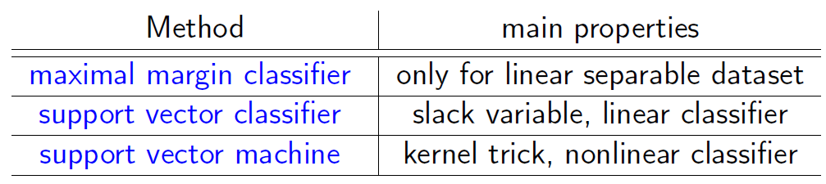
Support Vector Machine (SVM)
Vapnik 1995: Geometric viewpoint + Primal-dual for quadratic programming (+ Kernel trick)
Mainly developed by and dominantly hot in computer science/pattern recognition throughout 1990’s.
One of the most important and successful developments before deep learning

Slide 3
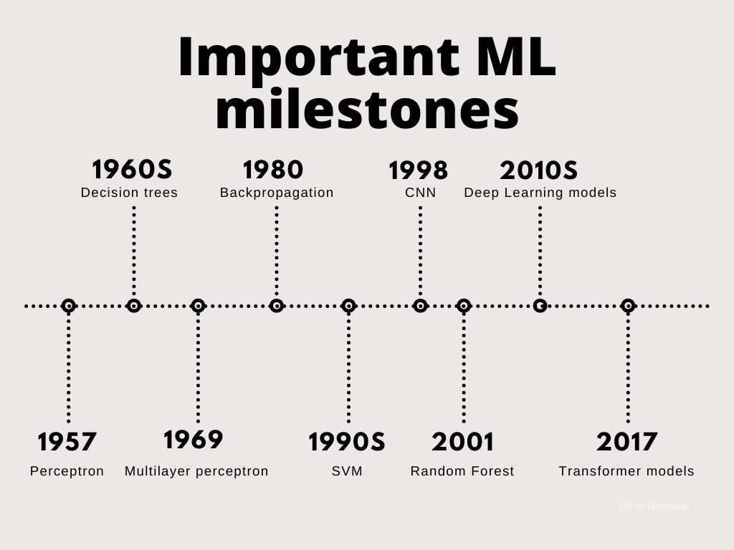
Machine Learning Milestones

Slide 4
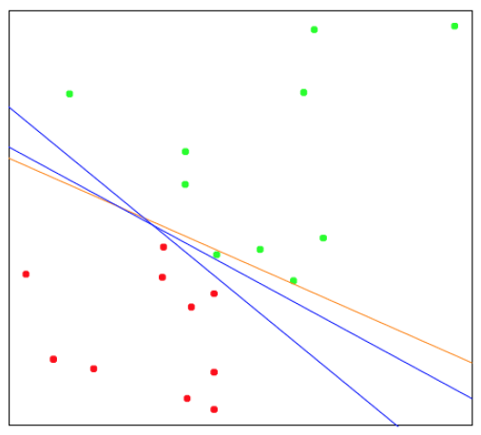
Idea of SVM
We try and find a plane that separates the classes in feature space.
If we cannot, we get creative in two ways: (1) soften what we mean by “separates”, and (2) enrich and enlarge the feature space so that separation is possible.

Slide 5
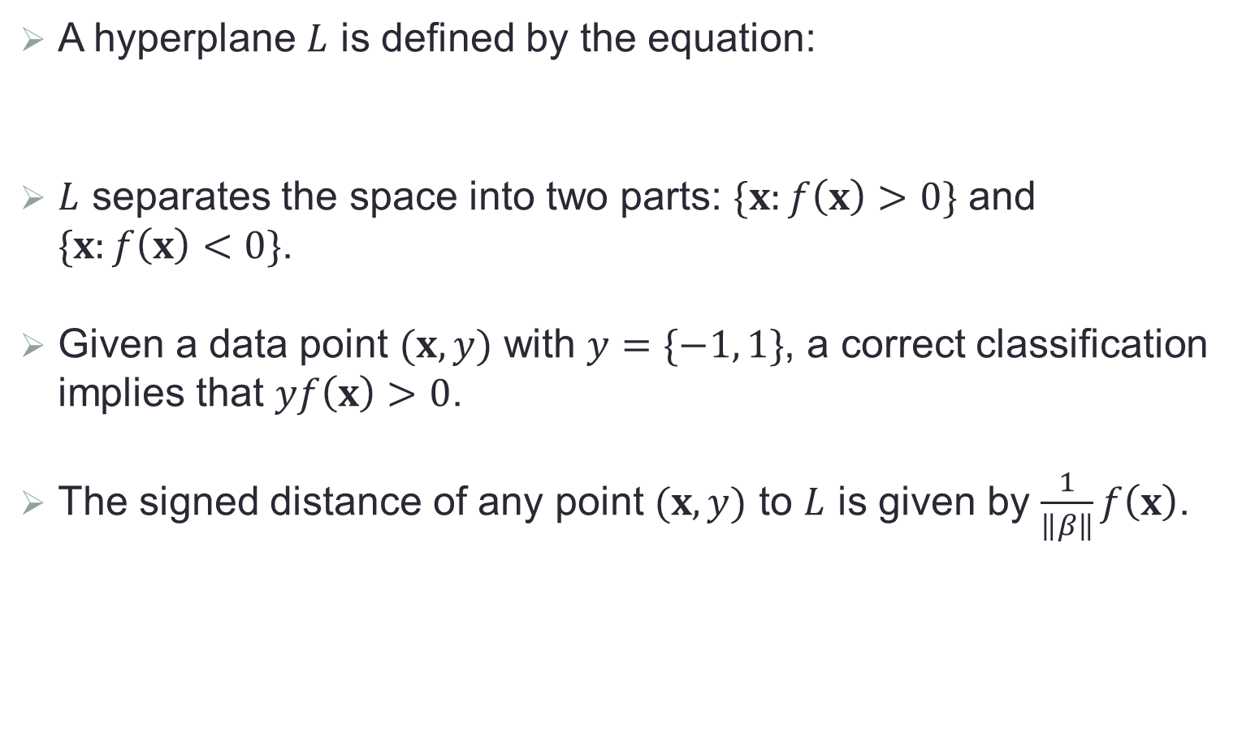

Review of Vector Algebra (Topic 6)
A hyperplane $L$ is defined by the equation:
$L$ separates the space into two parts: $\{x:f\left(x\right)>0\}$ and $\{x:f\left(x\right)<0\}$.
Given a data point $(x, y)$ with $y=\{−1, 1\}$, a correct classification implies that $yf\left(x\right)>0$.
The signed distance of any point $(x, y)$ to $L$ is given by $\frac{1}{\left\|β\right\|}f\left(x\right)$.
$$L=\{x:f\left(x\right)=β_{0}+x^{T}β=0\}$$

Slide 6
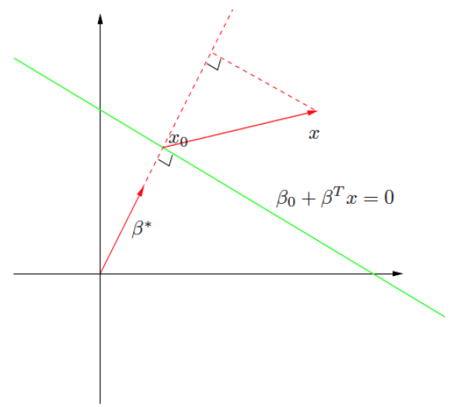
Geometry of A Hyperplane

Slide 7
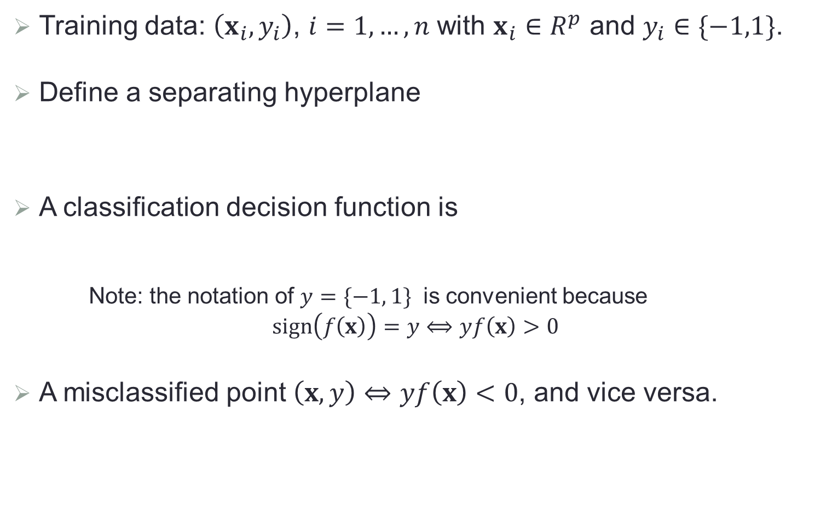

Preliminaries
Training data: $\left(x_{i},y_{i}\right)$, $i=1,…,n$ with $x_{i}∈R^{p}$ and $y_{i}∈\{−1,1\}$.
Define a separating hyperplane
A classification decision function is
Note: the notation of $y=\{−1, 1\}$ is convenient because
$$sign\left(f\left(x\right)\right)=y⟺yf\left(x\right)>0$$
A misclassified point $\left(x, y\right)⇔yf\left(x\right)<0$, and vice versa.
$$L=\{x:f\left(x\right)=β_{0}+x^{T}β=0\}$$
$$G\left(x\right)=sign\left(f\left(x\right)\right)=sign(β_{0}+x^{T}β)$$

Slide 8
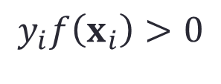
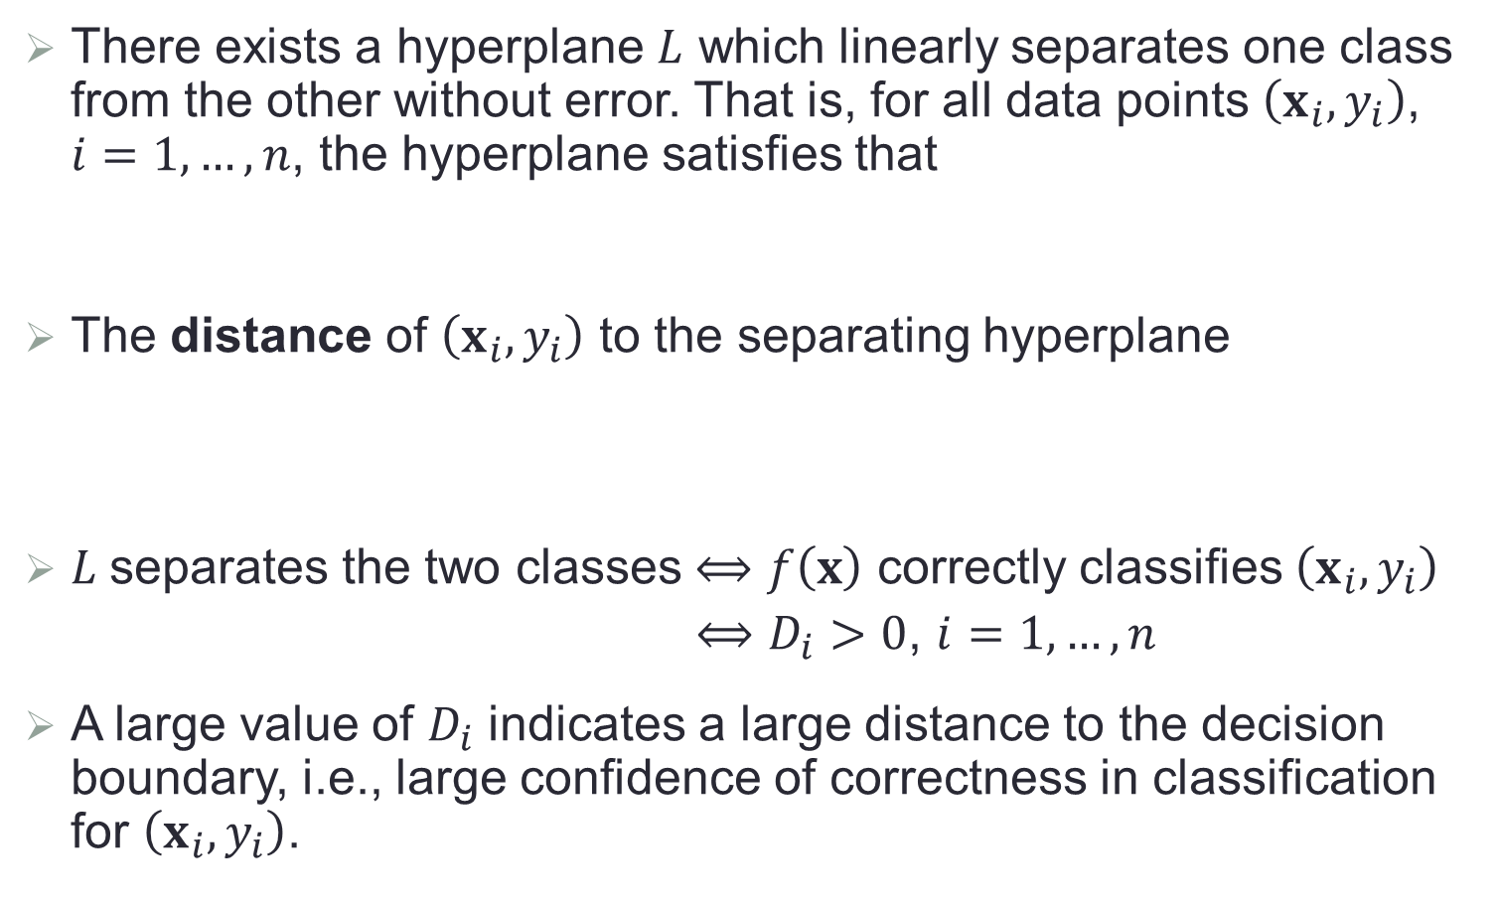
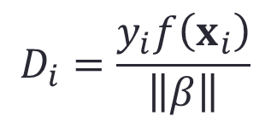
Separable Case
There exists a hyperplane $L$ which linearly separates one class from the other without error. That is, for all data points $\left(x_{i},y_{i}\right)$, $i=1,…,n$, the hyperplane satisfies that
The distance of $\left(x_{i},y_{i}\right)$ to the separating hyperplane
$L$separates the two classes $⟺$ $f\left(x\right)$ correctly classifies $\left(x_{i},y_{i}\right)$
$⟺$ $D_{i}>0$, $i=1,…,n$
A large value of $D_{i}$ indicates a large distance to the decision boundary, i.e., large confidence of correctness in classification for $\left(x_{i},y_{i}\right)$.
$$y_{i}f\left(x_{i}\right)>0$$
$$D_{i}=\frac{y_{i}f\left(x_{i}\right)}{\left\|β\right\|}$$

Slide 9
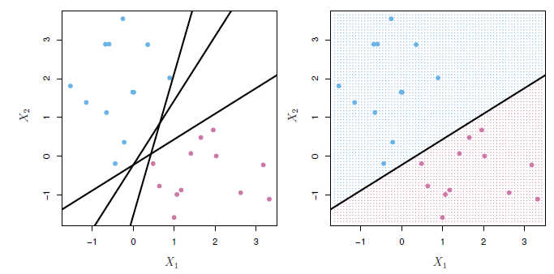
Illustrative Plot: Separating Hyperplane

Slide 10
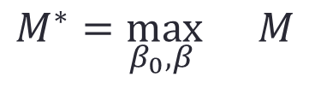
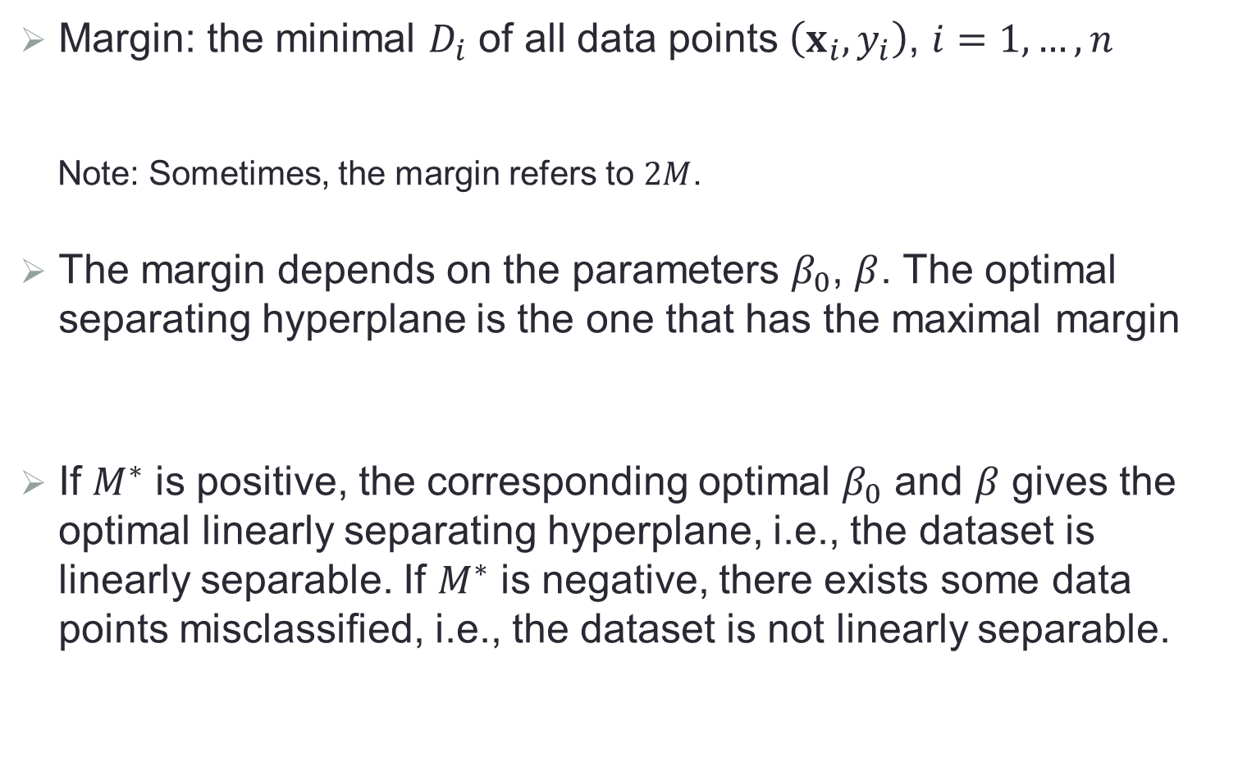

Maximal Margin Classifier
Margin: the minimal $D_{i}$ of all data points $\left(x_{i},y_{i}\right)$, $i=1,…,n$
Note: Sometimes, the margin refers to $2M$.
The margin depends on the parameters $β_{0}$, $β$. The optimal separating hyperplane is the one that has the maximal margin
If $M^{∗}$ is positive, the corresponding optimal $β_{0}$ and $β$ gives the optimal linearly separating hyperplane, i.e., the dataset is linearly separable. If $M^{∗}$ is negative, there exists some data points misclassified, i.e., the dataset is not linearly separable.
$${M=\min_{1≤i≤n}{D}}_{i}$$
$$M^{∗}=\max_{β_{0},β }{ M}$$

Slide 11
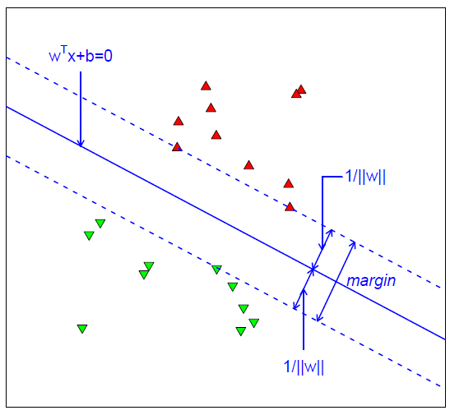



Illustrative Plot: Maximal Margin Classifier
$${x_{i}}^{T}β+β_{0}=0$$
$$M$$
$$M$$

Slide 12
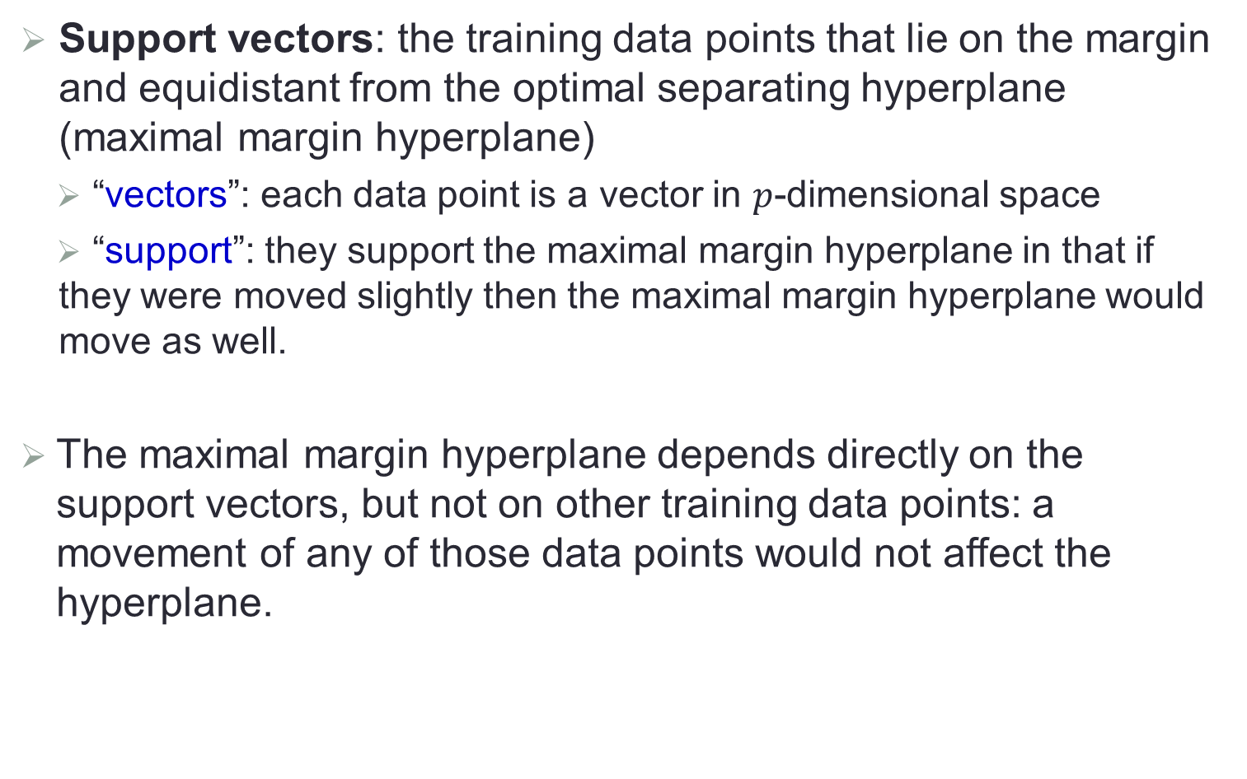
Support Vectors
Support vectors: the training data points that lie on the margin and equidistant from the optimal separating hyperplane (maximal margin hyperplane)
“vectors”: each data point is a vector in $p$-dimensional space
“support”: they support the maximal margin hyperplane in that if they were moved slightly then the maximal margin hyperplane would move as well.
The maximal margin hyperplane depends directly on the support vectors, but not on other training data points: a movement of any of those data points would not affect the hyperplane.

Slide 13
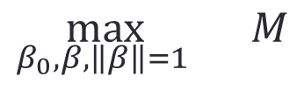
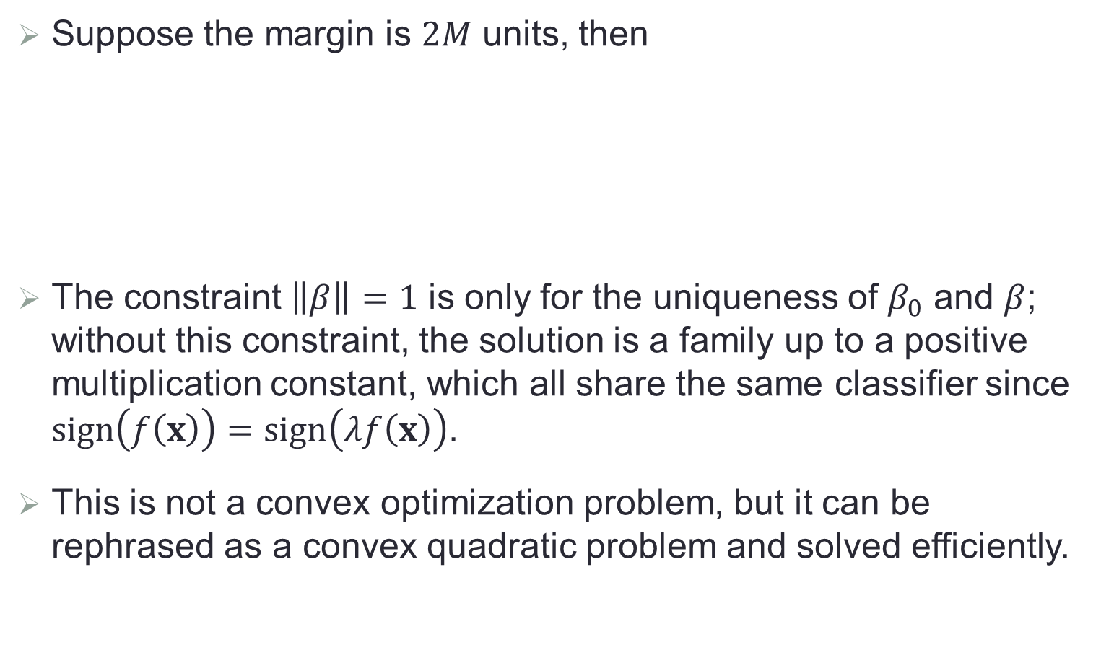
Optimization Formulation
Suppose the margin is $2M$ units, then
The constraint $\left\|β\right\|=1$ is only for the uniqueness of $β_{0}$ and $β$; without this constraint, the solution is a family up to a positive multiplication constant, which all share the same classifier since $sign\left(f\left(x\right)\right)=sign\left(λf\left(x\right)\right)$.
This is not a convex optimization problem, but it can be rephrased as a convex quadratic problem and solved efficiently.
$$\max_{β_{0},β,\left\|β\right\|=1 }{ M}$$
subject to $y_{i}\left({x_{i}}^{T}β+β_{0}\right)≥M$, $i=1,…,n$

Slide 14
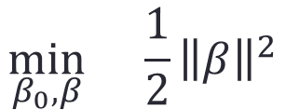
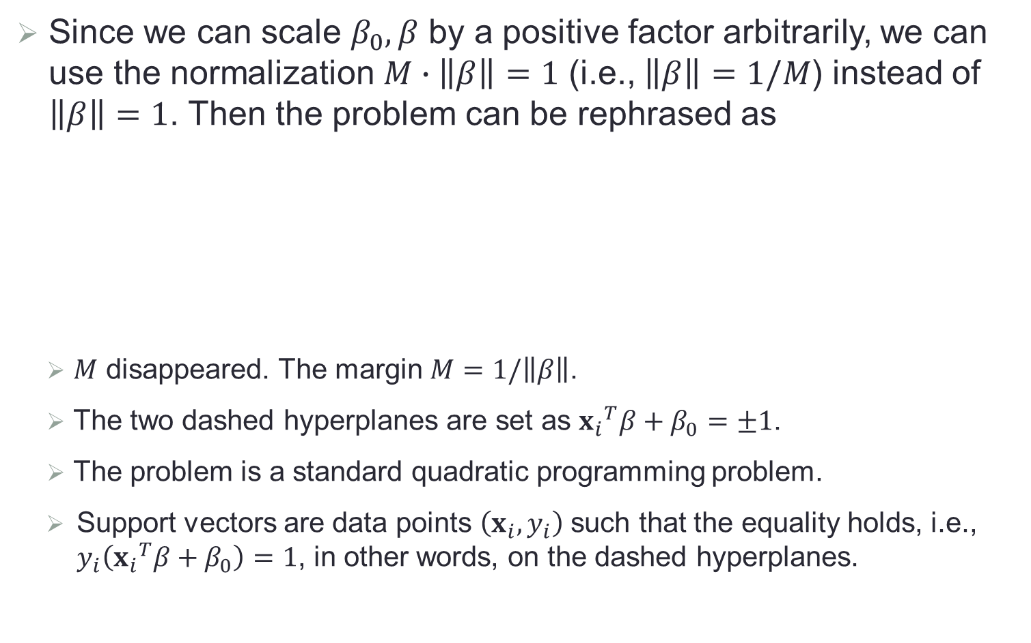
Optimization Formulation (Cont.)
Since we can scale $β_{0},β$ by a positive factor arbitrarily, we can use the normalization $M∙\left\|β\right\|=1$ (i.e., $\left\|β\right\|=1/M$) instead of $\left\|β\right\|=1$. Then the problem can be rephrased as
$M$ disappeared. The margin $M=1/\left\|β\right\|$.
The two dashed hyperplanes are set as ${x_{i}}^{T}β+β_{0}=±1$.
The problem is a standard quadratic programming problem.
Support vectors are data points $\left(x_{i},y_{i}\right)$ such that the equality holds, i.e., $y_{i}\left({x_{i}}^{T}β+β_{0}\right)=1$, in other words, on the dashed hyperplanes.
$$\min_{β_{0},β}{ \frac{1}{2}{\left\|β\right\|}^{2}}$$
subject to $y_{i}\left({x_{i}}^{T}β+β_{0}\right)≥1$, $i=1,…,n$

Slide 15




Illustrative Plot: Rephrased Formulation
$${x_{i}}^{T}β+β_{0}=0$$
$$\frac{1}{\left\|β\right\|}$$
$${x_{i}}^{T}β+β_{0}=1$$
$$\frac{1}{\left\|β\right\|}$$
$${x_{i}}^{T}β+β_{0}=−1$$

Slide 16
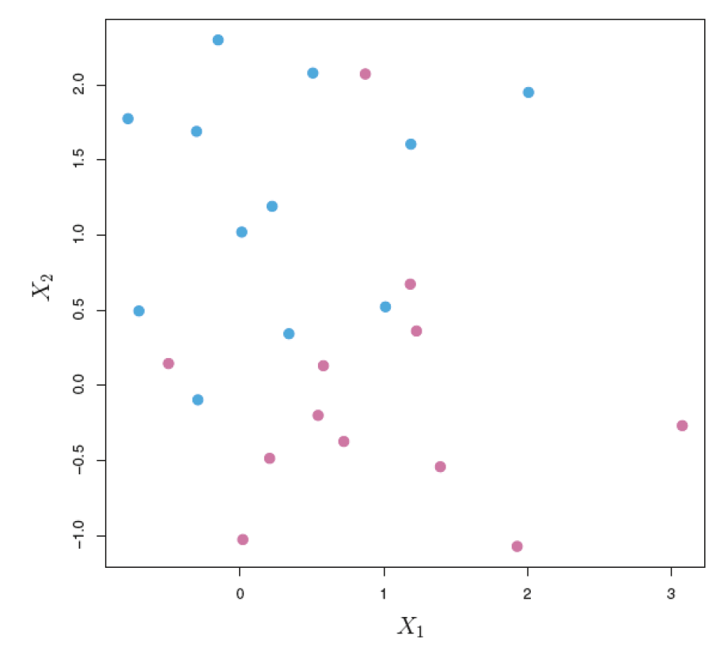
Non-Separable Case
Data that are not linearly separable

Slide 17
Disadvantage of Maximal Margin Classifier
In the separable case, the separating hyperplane is sensitive to individual observations: the addition of a single observation may lead to dramatic change in the maximal margin hyperplane.
Reason: margin is tiny

Slide 18
Idea of Support Vector Classifier
Consider a hyperplane that does not perfectly separate the two classes, in the interest of
(1) Greater robustness to individual observations, and
(2) Correct classification of most of the training observations
It could be worthwhile to misclassify a few training points in order to do a better job in classifying the remaining points.
Soft margin classifier: the margin is “soft” because it can be violated by some of the training points.

Slide 19
Idea of Support Vector Classifier (Cont.)
Rather than seeking the largest possible margin so that every data point is not only on the correct side of the hyperplane but also on the correct side of the margin, we instead allow some data points to be on the incorrect side of the margin, or even the incorrect side of the hyperplane.
A data point can be not only on the wrong side of the margin, but also on the wrong side of the hyperplane. Data points on the wrong side of the hyperplane correspond to training observations that are misclassified by the support vector classifier.

Slide 20
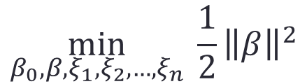
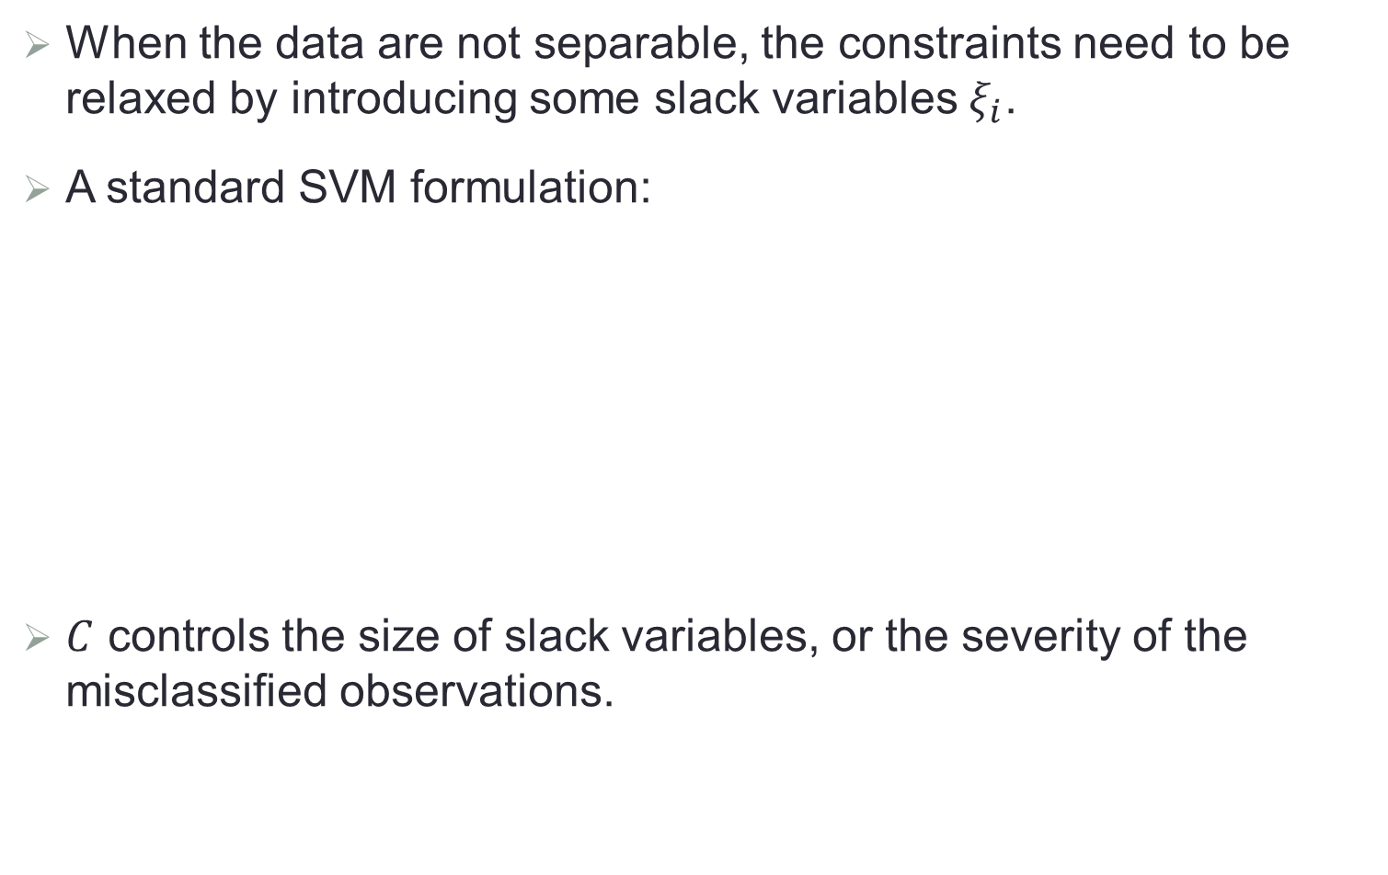
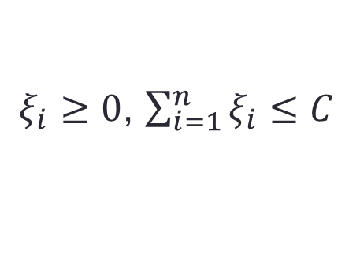
Optimization Formulation in Non-Separable Case
When the data are not separable, the constraints need to be relaxed by introducing some slack variables $ξ_{i}$.
A standard SVM formulation:
$C$ controls the size of slack variables, or the severity of the misclassified observations.
$$\min_{β_{0},β,ξ_{1},ξ_{2},…,ξ_{n}}{ \frac{1}{2}{\left\|β\right\|}^{2}}$$
subject to $y_{i}\left({x_{i}}^{T}β+β_{0}\right)≥1−ξ_{i}$, $i=1,…,n$
$ξ_{i}≥0$, $\sum_{i=1}^{n}{ξ_{i}}≤C$

Slide 21
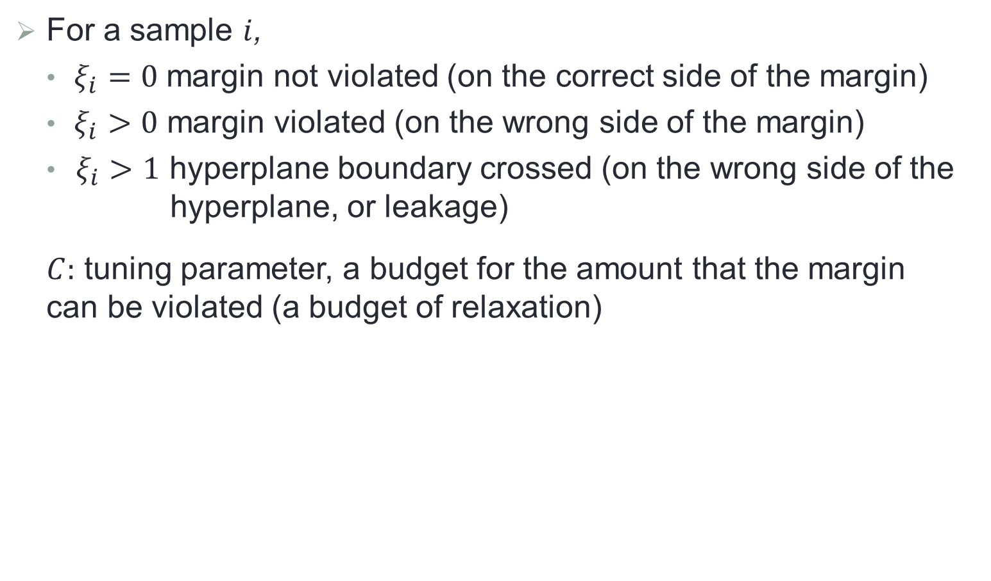
Slack Variables and Tuning Parameter
For a sample $i$,
$ξ_{i}=0$ margin not violated (on the correct side of the margin)
$ξ_{i}>0$ margin violated (on the wrong side of the margin)
$ξ_{i}>1$ hyperplane boundary crossed (on the wrong side of the
hyperplane, or leakage)
$C:$ tuning parameter, a budget for the amount that the margin can be violated (a budget of relaxation)

Slide 22
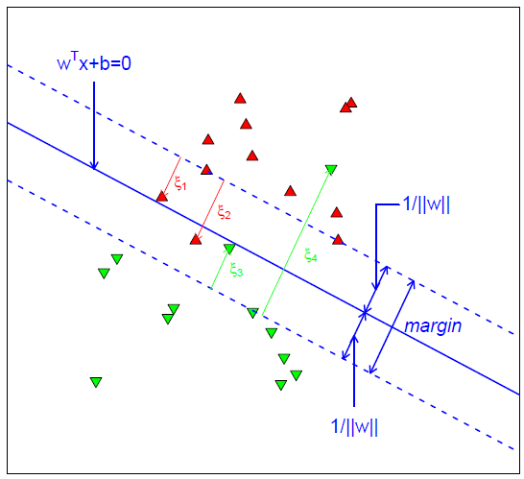



Illustrative Plot: Nonseparable
$${x_{i}}^{T}β+β_{0}=0$$
$$\frac{1}{\left\|β\right\|}$$
$$\frac{1}{\left\|β\right\|}$$

Slide 23
Effect of Slack Variable
3,4,5,6: on the correct side of the margin
2: on the margin
1: on the wrong side of the margin
7,10: on the correct side of the margin
9: on the margin
8: on the wrong side of the margin
11,12: on the wrong side of the margin and the wrong side of the hyperplane

Slide 24
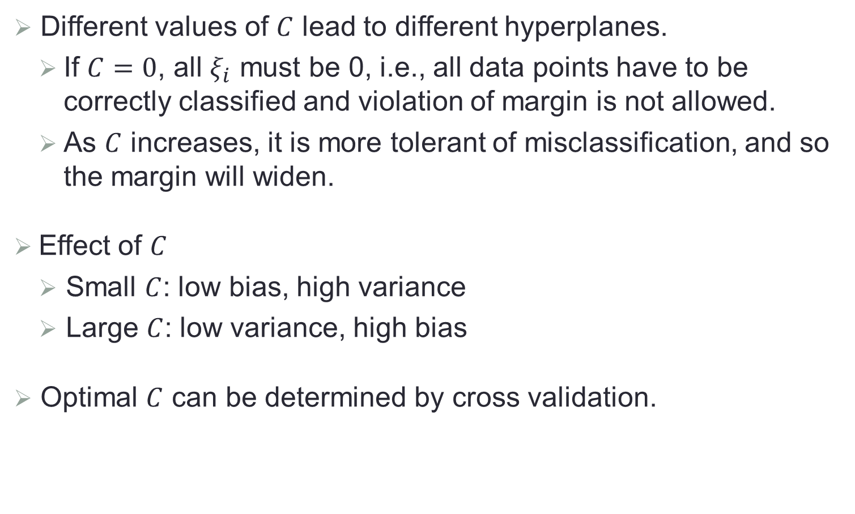
Tuning Parameter
Different values of $C$ lead to different hyperplanes.
If $C=0$, all $ξ_{i}$ must be 0, i.e., all data points have to be correctly classified and violation of margin is not allowed.
As $C$ increases, it is more tolerant of misclassification, and so the margin will widen.
Effect of $C$
Small $C$: low bias, high variance
Large $C$: low variance, high bias
Optimal $C$ can be determined by cross validation.

Slide 25
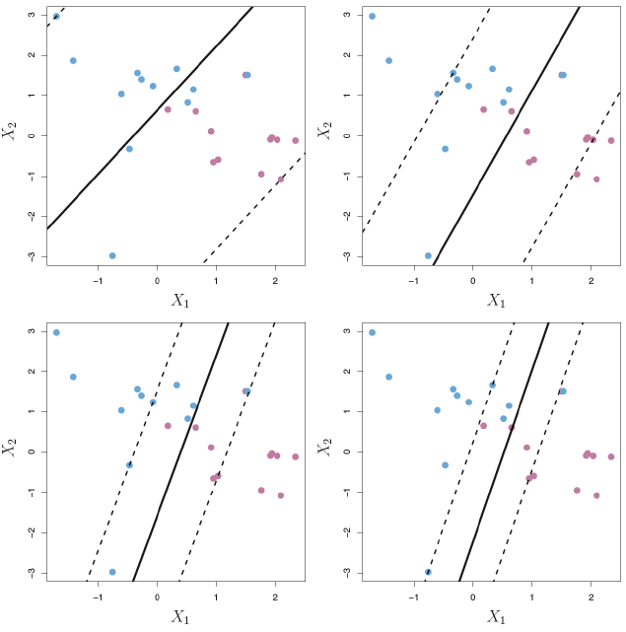
Example of Tuning Parameter

Slide 26
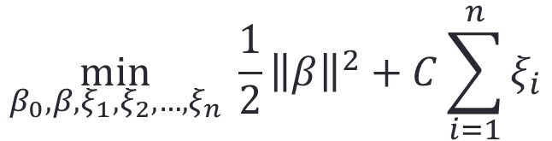
Optimization
First, the SVM formulation is equivalent to
This problem can be solved using Lagrange multiplier.
$$\min_{β_{0},β,ξ_{1},ξ_{2},…,ξ_{n}}{ \frac{1}{2}{\left\|β\right\|}^{2}+C\sum_{i=1}^{n}{ξ_{i}}}$$
subject to $y_{i}\left({x_{i}}^{T}β+β_{0}\right)≥1−ξ_{i}$, $i=1,…,n$, $ξ_{i}≥0$

Slide 27

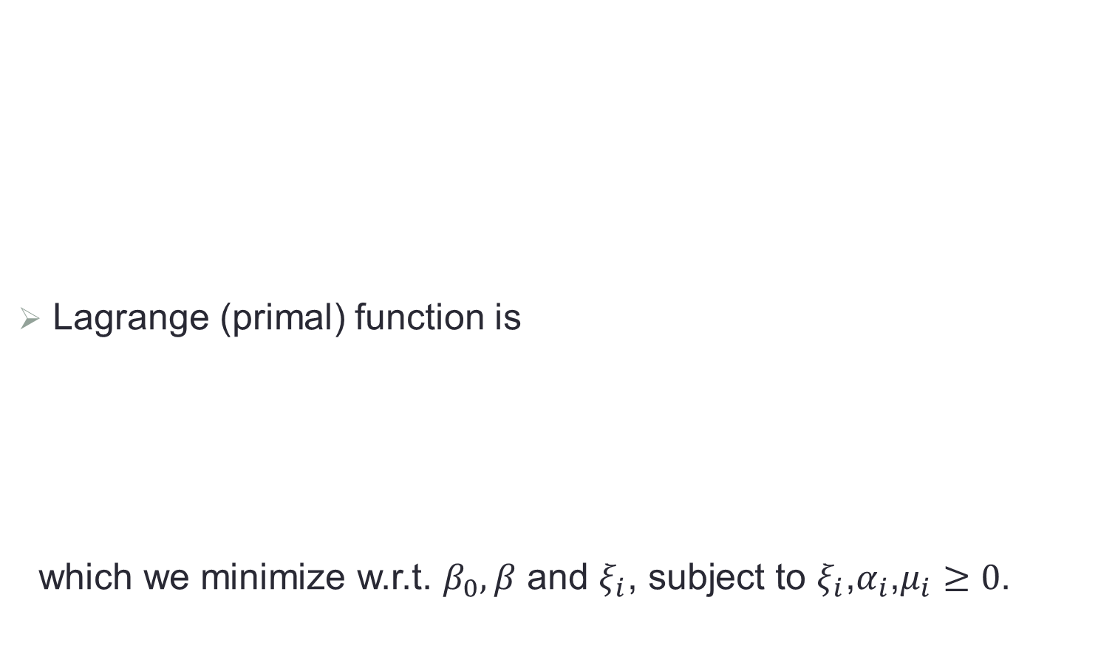
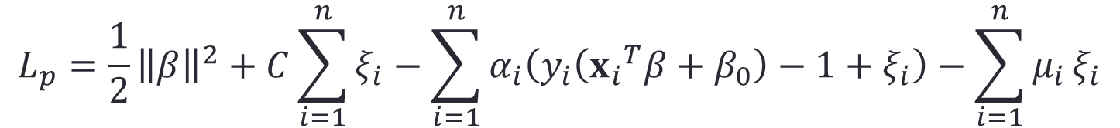
Optimization (Cont.)
Lagrange (primal) function is
which we minimize w.r.t. $β_{0},β$ and $ξ_{i}$, subject to $ξ_{i}$,$α_{i}$,$μ_{i}≥0$.
$$\min_{β_{0},β,ξ_{1},ξ_{2},…,ξ_{n}}{ \frac{1}{2}{\left\|β\right\|}^{2}+C\sum_{i=1}^{n}{ξ_{i}}}$$
subject to $y_{i}\left({x_{i}}^{T}β+β_{0}\right)≥1−ξ_{i}$, $i=1,…,n$, $ξ_{i}≥0$
$$L_{p}=\frac{1}{2}{\left\|β\right\|}^{2}+C\sum_{i=1}^{n}{ξ_{i}}−\sum_{i=1}^{n}{α_{i}\left(y_{i}\left({x_{i}}^{T}β+β_{0}\right)−1+ξ_{i}\right)}−\sum_{i=1}^{n}{μ_{i}}ξ_{i}$$

Slide 28
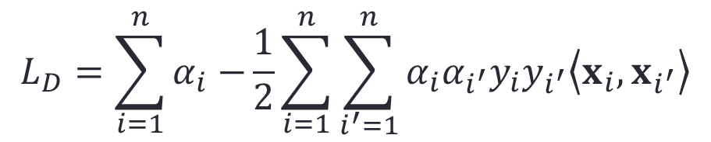
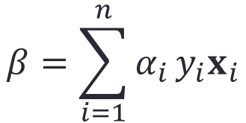
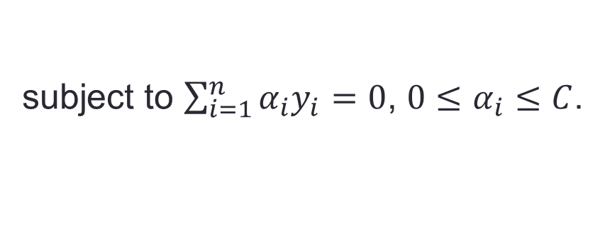
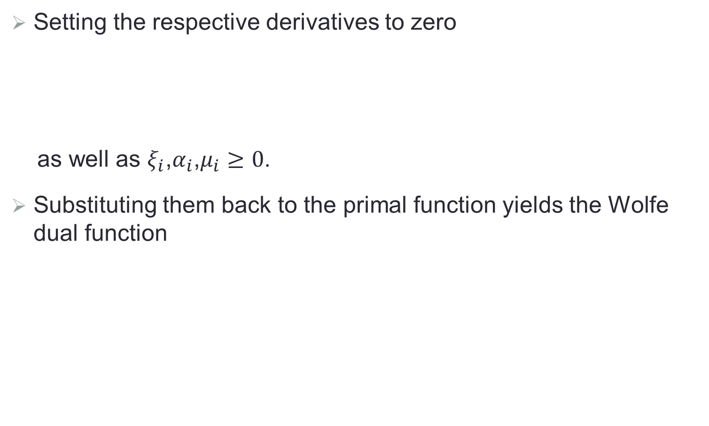

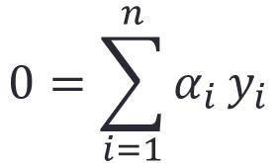
Dual Form
Setting the respective derivatives to zero
as well as $ξ_{i}$,$α_{i}$,$μ_{i}≥0$.
Substituting them back to the primal function yields the Wolfe dual function
$$β=\sum_{i=1}^{n}{α_{i}}y_{i}x_{i}$$
$$0=\sum_{i=1}^{n}{α_{i}}y_{i}$$
$$C=α_{i}+μ_{i}$$
$$L_{D}=\sum_{i=1}^{n}{α_{i}−}\frac{1}{2}\sum_{i=1}^{n}{\sum_{i^{′}=1}^{n}{α_{i}α_{i^{′}}y_{i}y_{i^{′}}\left\langle x_{i},x_{i^{′}}\right\rangle }}$$
subject to $\sum_{i=1}^{n}{α_{i}y_{i}=0}$, $0≤α_{i}≤C$.

Slide 29

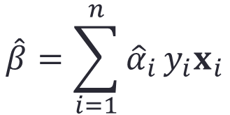


KKT Conditions
The solutions to the primal and the dual forms are equivalent
The solutions to the primal and the dual forms must satisfy the Karush-Kuhn-Tucker conditions:
$$\hat{β}=\sum_{i=1}^{n}{{\hat{α}}_{i}}y_{i}x_{i}$$
$$α_{i}\left(y_{i}\left({x_{i}}^{T}β+β_{0}\right)−1+ξ_{i}\right)=0$$
$$μ_{i}ξ_{i}=0$$
$y_{i}\left({x_{i}}^{T}β+β_{0}\right)≥1−$ $ξ_{i}$

Slide 30

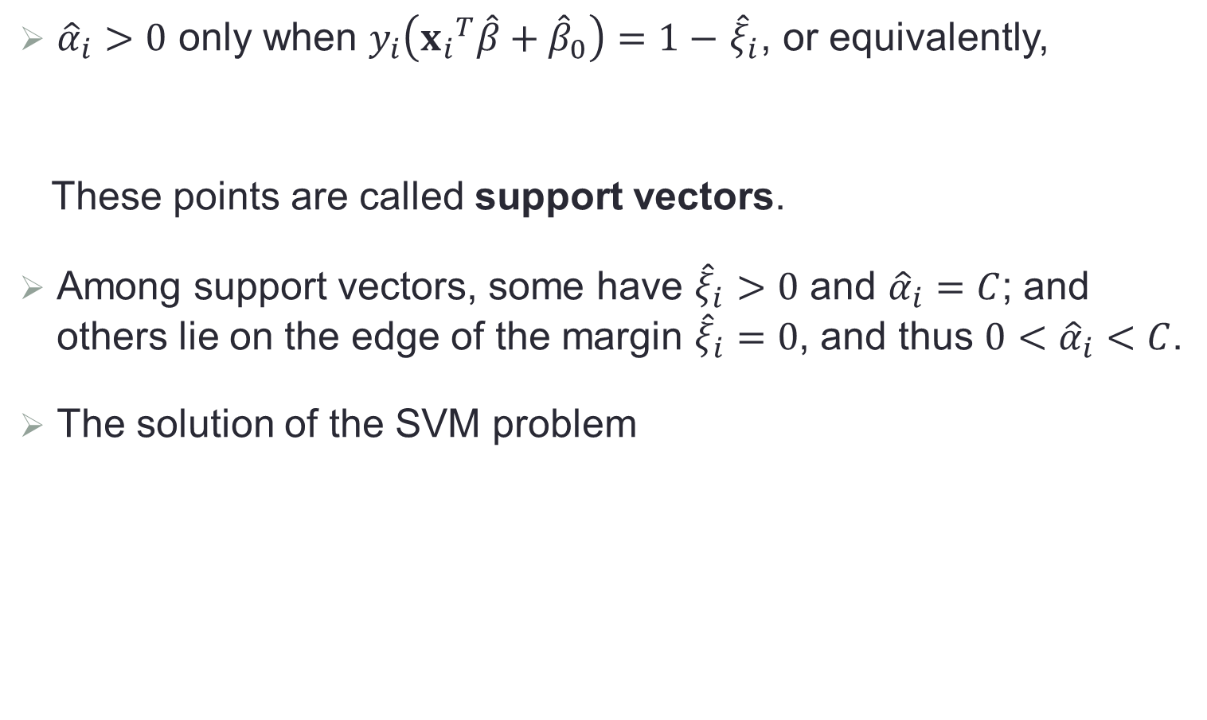
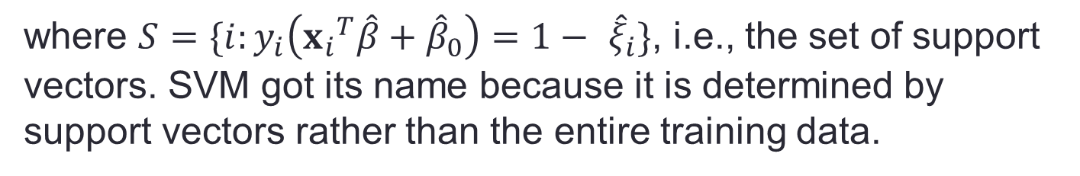
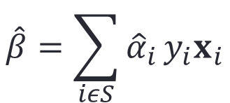
More on KKT Conditions
${\hat{α}}_{i}>0$ only when $y_{i}\left({x_{i}}^{T}\hat{β}+{\hat{β}}_{0}\right)=1−$ ${\hat{ξ}}_{i}$, or equivalently,
These points are called support vectors.
Among support vectors, some have ${\hat{ξ}}_{i}>0$ and ${\hat{α}}_{i}=C$; and others lie on the edge of the margin ${\hat{ξ}}_{i}=0$, and thus ${0<\hat{α}}_{i}<C$.
The solution of the SVM problem
$$y_{i}\left({x_{i}}^{T}\hat{β}+{\hat{β}}_{0}\right)≤1$$
$$\hat{β}=\sum_{iεS}{{\hat{α}}_{i}}y_{i}x_{i}$$
where $S=\{i:y_{i}\left({x_{i}}^{T}\hat{β}+{\hat{β}}_{0}\right)=1− {\hat{ξ}}_{i}\}$, i.e., the set of support vectors. SVM got its name because it is determined by support vectors rather than the entire training data.

Slide 31
Illustrative Plot: Support Vectors in Nonseparable Case
$${x_{i}}^{T}β+β_{0}=0$$
$$\frac{1}{\left\|β\right\|}$$
$$\frac{1}{\left\|β\right\|}$$

Slide 32
Remarks
Computational complexity of training support vector classifier is characterized by the number of support vectors rather than the dimensionality. So it works well on small as well as high dimensional problems.
They are not suitable for larger datasets because the training time with SVM can be high and much more computationally intensive.
The solution is robust because it is insensitive to outliers (data points that are significantly far from the decision boundary.)

Slide 33
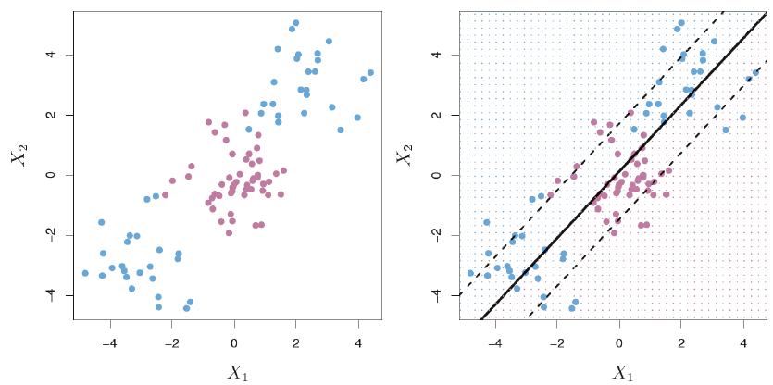
Nonlinear Decision Boundary: A Toy Example
When the classes have nonlinear boundary, linear SVM will perform very poorly.

Slide 34
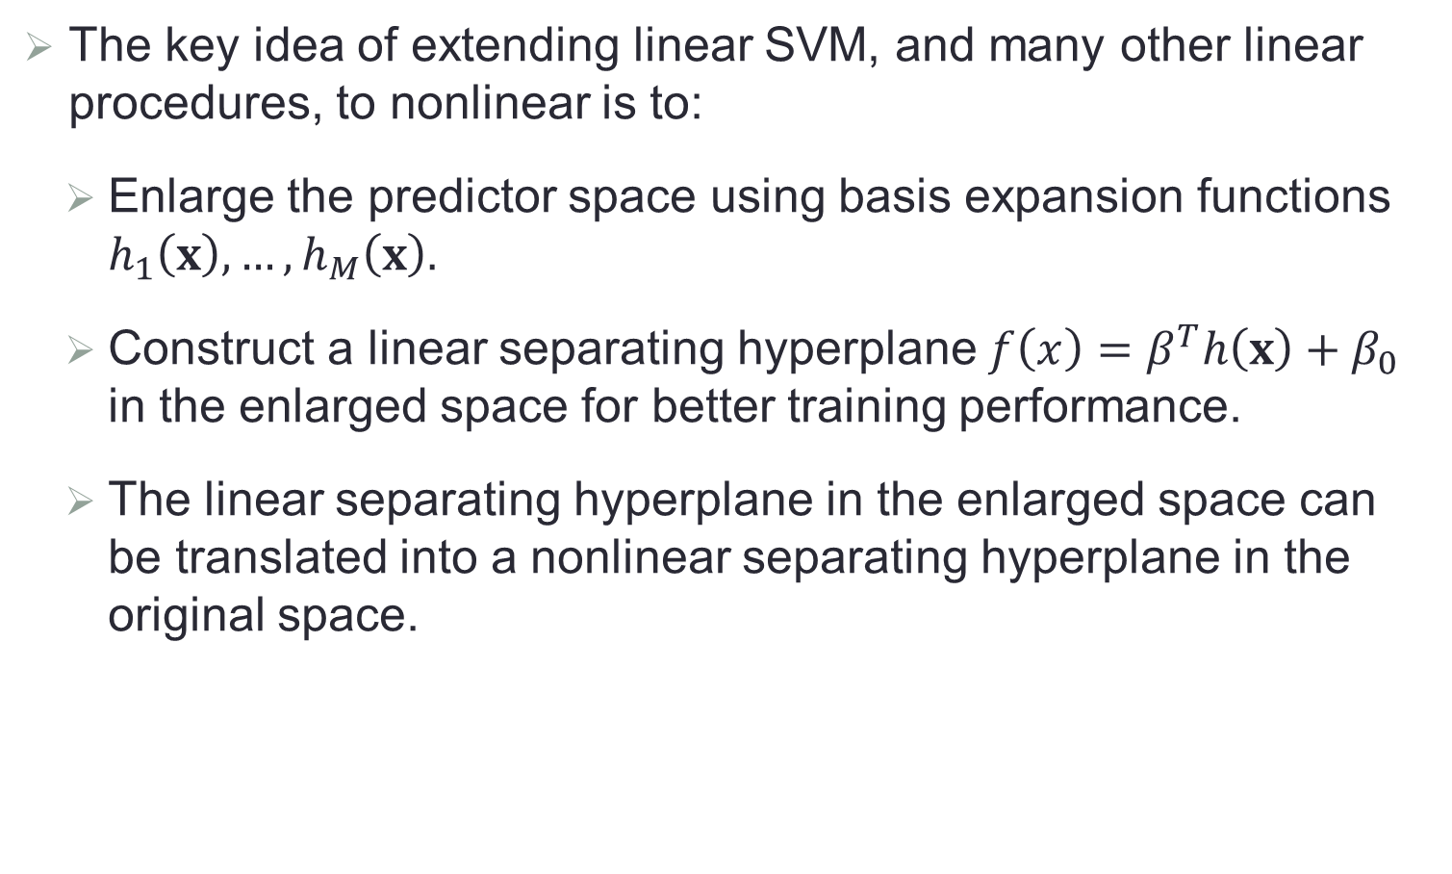
Extending Linear SVM to Nonlinear SVM
The key idea of extending linear SVM, and many other linear procedures, to nonlinear is to:
Enlarge the predictor space using basis expansion functions $h_{1}\left(x\right),…,h_{M}\left(x\right).$
Construct a linear separating hyperplane $f\left(x\right)=β^{T}h\left(x\right)+β_{0}$ in the enlarged space for better training performance.
The linear separating hyperplane in the enlarged space can be translated into a nonlinear separating hyperplane in the original space.

Slide 35
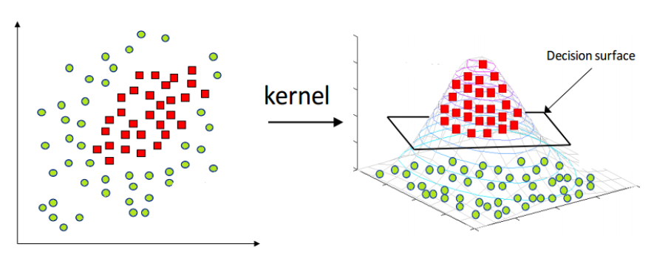
Illustrative Plot: Extension to Nonlinear Decision Boundary
Cover’s theorem: pattern-classification problem cast in a high dimensional space non-linearly is more likely to be linearly separable than in a low dimensional space.

Slide 36
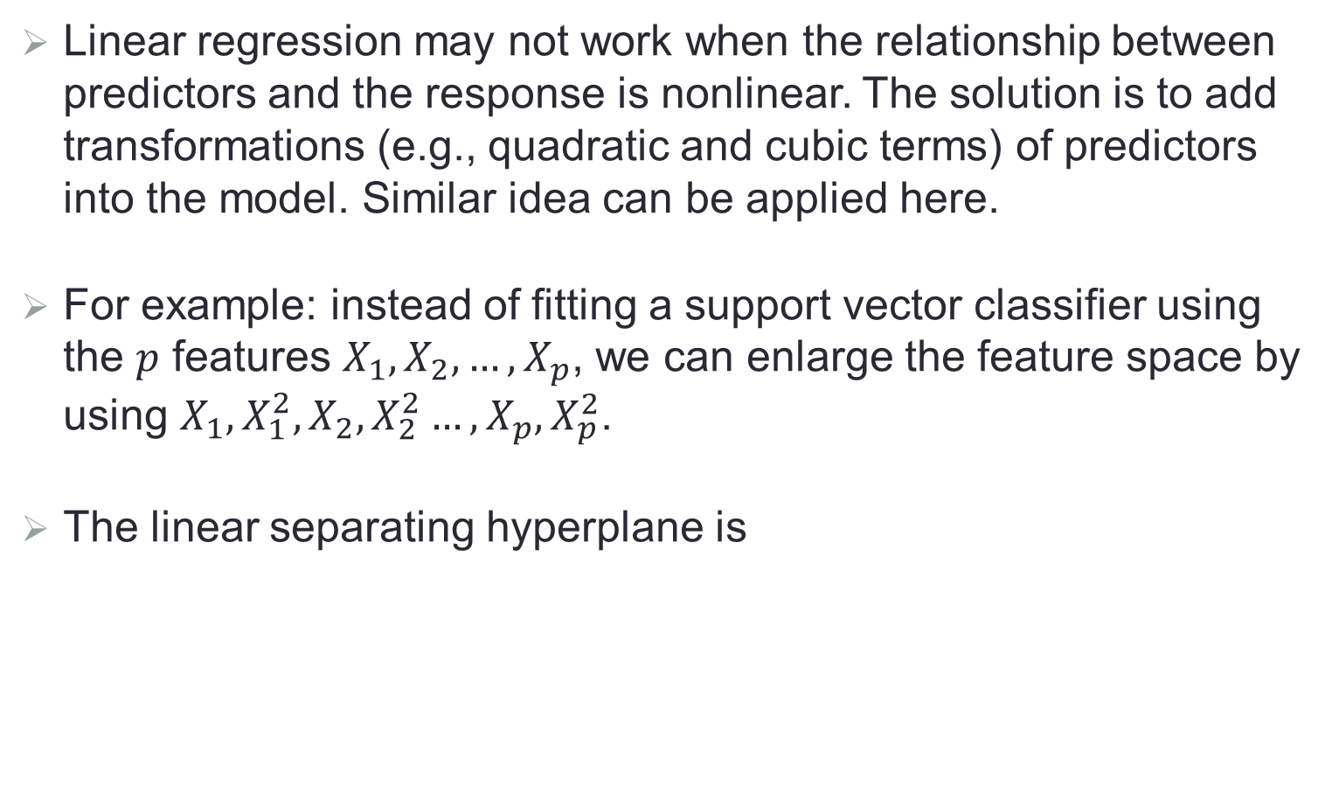
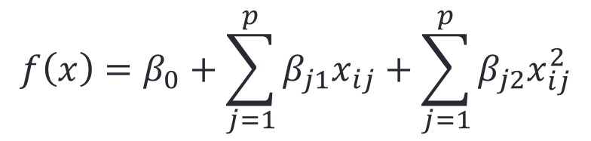
Recall: Linear Regression
Linear regression may not work when the relationship between predictors and the response is nonlinear. The solution is to add transformations (e.g., quadratic and cubic terms) of predictors into the model. Similar idea can be applied here.
For example: instead of fitting a support vector classifier using the $p$ features $X_{1},X_{2},…,X_{p}$, we can enlarge the feature space by using $X_{1},{X_{1}^{2},X}_{2},X_{2}^{2}…,X_{p},X_{p}^{2}$.
The linear separating hyperplane is
$$f\left(x\right)=β_{0}+\sum_{j=1}^{p}{β_{j1}x_{ij}+\sum_{j=1}^{p}{β_{j2}x_{ij}^{2}}}$$

Slide 37
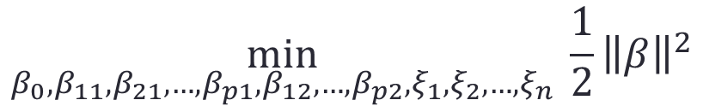
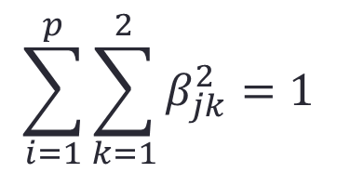
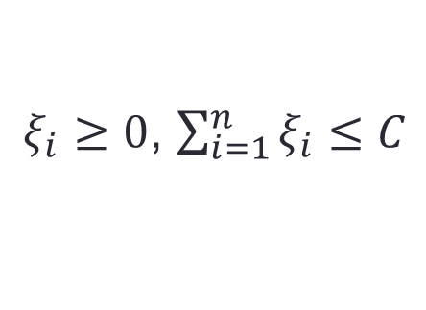
Modified Optimization Formulation
The SVM formulation becomes
$$\min_{β_{0},β_{11},β_{21},{…,β}_{p1},β_{12},…,β_{p2},ξ_{1},ξ_{2},…,ξ_{n}}{ \frac{1}{2}{\left\|β\right\|}^{2}}$$
subject to $y_{i}\left(β_{0}+\sum_{j=1}^{p}{β_{j1}x_{ij}+\sum_{j=1}^{p}{β_{j2}x_{ij}^{2}}}\right)≥1−ξ_{i}$
$ξ_{i}≥0$, $\sum_{i=1}^{n}{ξ_{i}}≤C$
$$\sum_{i=1}^{p}{\sum_{k=1}^{2}{β_{jk}^{2}}}=1$$

Slide 38
Example

Slide 39
However…
Including quadratic terms is only one way to enlarge the feature space in order to accommodate nonlinearity.
There are many possible ways to enlarge the feature space. Unless we are careful, we could end up with a huge number of features. Then computations would become unmanageable.
The support vector machine allows us to enlarge the feature space in a way that leads to efficient computations (kernel trick).

Slide 40
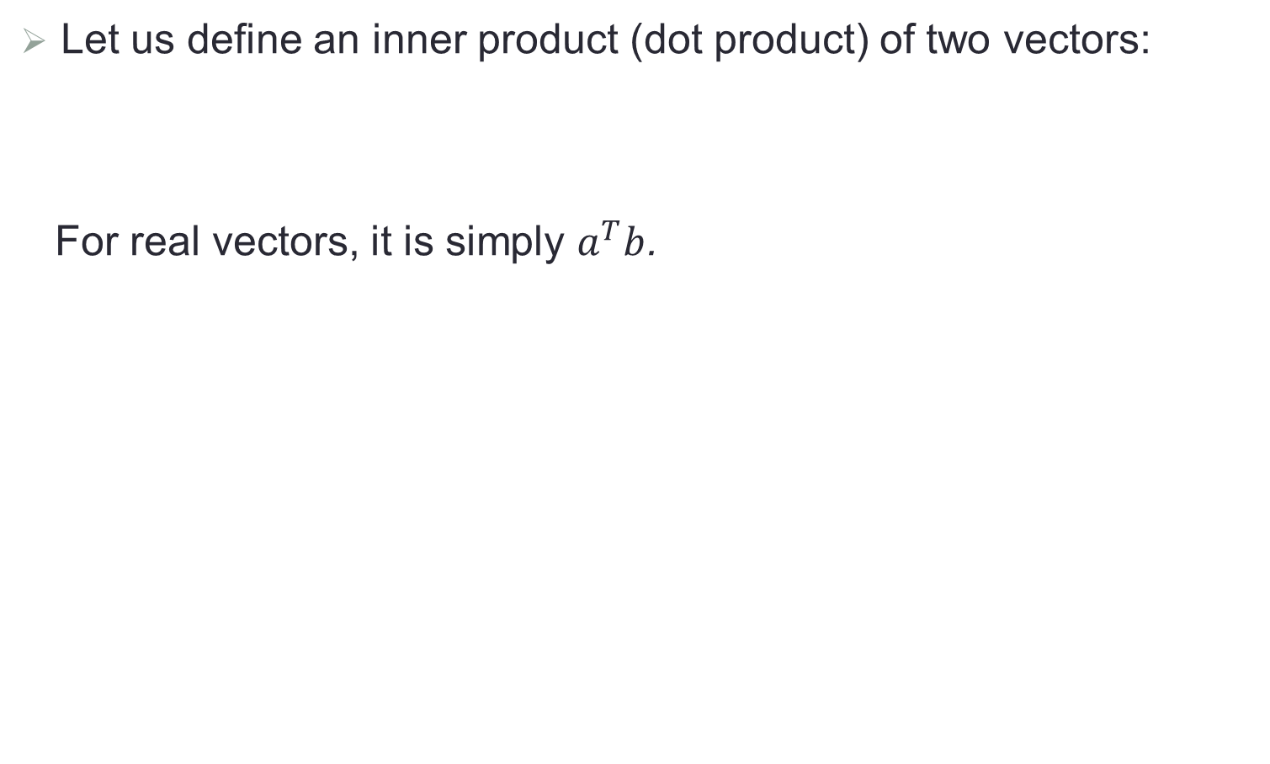
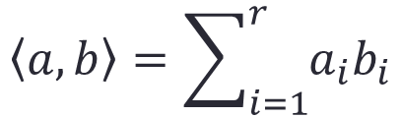
Inner Product
Let us define an inner product (dot product) of two vectors:
For real vectors, it is simply $a^{T}b$.
$$\left\langle a,b\right\rangle =\sum_{i=1}^{r}{a_{i}b_{i}}$$

Slide 41
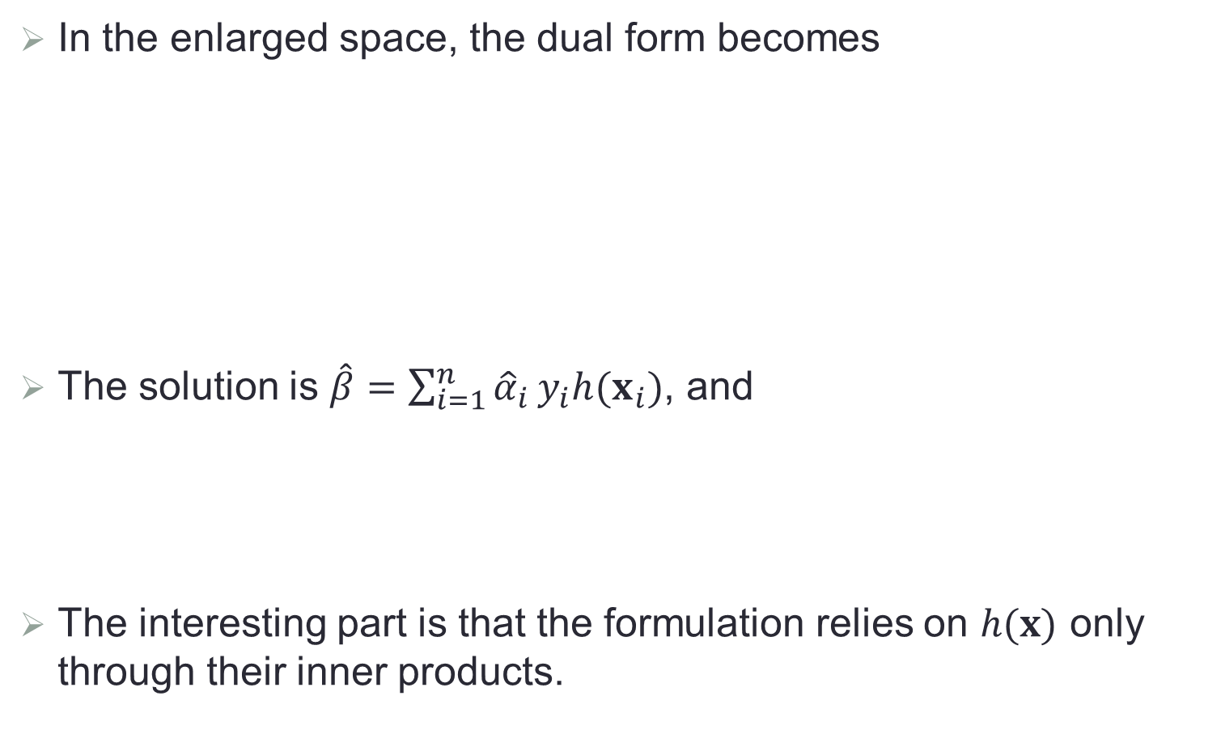
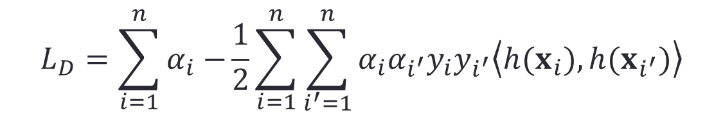


Kernel Trick
In the enlarged space, the dual form becomes
The solution is $\hat{β}=\sum_{i=1}^{n}{{\hat{α}}_{i}}y_{i}h(x_{i})$, and
The interesting part is that the formulation relies on $h(x)$ only through their inner products.
$$L_{D}=\sum_{i=1}^{n}{α_{i}−}\frac{1}{2}\sum_{i=1}^{n}{\sum_{i^{′}=1}^{n}{α_{i}α_{i^{′}}y_{i}y_{i^{′}}\left\langle h(x_{i}),h(x_{i^{′}})\right\rangle }}$$
subject to $\sum_{i=1}^{n}{α_{i}y_{i}=0}$, $0≤α_{i}≤C$.
$$\hat{f}\left(x\right)={\hat{β}}^{T}h\left(x\right)+{\hat{β}}_{0}=\sum_{i=1}^{n}{{\hat{α}}_{i}}y_{i}\left\langle h\left(x_{i}\right),h(x)\right\rangle +{\hat{β}}_{0}$$

Slide 42


Kernels
Define
and thus we need not satisfy $h(∙)$ at all, but only $K\left(∙,∙ \right)$. $K(∙,∙)$ is called the kernel (function), which is a function that quantifies the similarity of two observations.
Popular choices of $K\left(∙,∙ \right)$:
Linear: $K\left(x,x^{′}\right)=x^{T}x^{′}$
Degree-d polynomial: $K\left(x,x^{′}\right)={(1+x^{T}x^{′})}^{d}$
Radial (Gaussian): $K\left(x,x^{′}\right)=exp\left(−γ{\left\|x−x^{′}\right\|}^{2}\right)$
$$K\left(x,x^{′}\right)=\left\langle h\left(x\right),h(x^{′})\right\rangle$$

Slide 43

Example of Nonlinear SVM
Left: SVM with a polynomial kernel of degree 3; Right: SVM with a radial kernel

Slide 44



Corresponding Basis Expansion Functions
In general, it is hard to find the basis expansion functions $h\left(∙\right)$ corresponding to a kernel function except the polynomial kernel.
Example: consider a polynomial kernel of degree 2 and $p=2$. If we choose
then we have the polynomial kernel
$$h_{1}\left(x\right)=1$$
$$h_{2}\left(x\right)=\sqrt{2}X_{1}$$
$$h_{3}\left(x\right)=\sqrt{2}X_{2}$$
$$h_{4}\left(x\right)=X_{1}^{2}$$
$$h_{5}\left(x\right)=X_{2}^{2}$$
$$h_{6}\left(x\right)=\sqrt{2}X_{1}X_{2}$$
$$K\left(x,x^{′}\right)={\left\langle h\left(x\right),h(x^{′})\right\rangle =(1+x^{T}x^{′})}^{2}$$

Slide 45

Advantage of Kernel
We use a kernel rather than simply enlarge the feature space using functions of the original features.
There is advantage on computation. Using kernel, we only need to compute the kernel $K(x_{i},x_{i^{′}})$ for $\left(\begin{matrix}n \\ 2\end{matrix}\right)$ distinct pairs $x_{i},x_{i^{′}}$. This can be done without explicitly working in the enlarged feature space.
This is important because in many applications of SVMs, the enlarged feature space is so large that computations are intractable. For some kernels, such as the radial kernel, the feature space is implicit and infinite-dimensional, so we could never do the computations there anyway!

Slide 46


Radial Kernel
The radial kernel
is also known as the Gaussian kernel.
When $x_{i}$ is far away from $x$, $K\left(x_{i},x\right)$ will be very tiny and thus $x_{i}$ has little effect on $\hat{f}(x)$.
The radial kernel has very local behavior, and only nearby training observations have effect on the prediction of a test observation.
$$K\left(x,x^{′}\right)=exp\left(−γ{\left\|x−x^{′}\right\|}^{2}\right)$$

Slide 47

Example: Heart Data
ROC curves for the training

Slide 48

Example: Heart Data (Cont.)
ROC curves for testing

Slide 49

Multiclass SVM
When the response $y∈\left\{1,…K\right\}$ with $K>2$:
One-versus-one approach
Construct $C_{K}^{2}$ binary SVM classifiers, each compares one pair of classes.
Assign the test observation to the class to which it was most frequently assigned in these $C_{K}^{2}$ pairwise classification.
One-versus-rest approach
Construct $K$ binary SVM classifiers, each compares one class to the rest $K−1$ classes.
Assign the test observation to the class for which the predicted function value is the largest.

Slide 50

Support Vector Regression
SVM can be extended to regression, called support vector regression (SVR).
Least squares regression seeks coefficients $β_{0}$, $β_{1}$,…, $β_{p}$ such that the sum of squared residuals is minimized. SVR instead seeks coefficients that minimize a different type of loss function.
In SVR, only residuals larger in absolute value than some positive constant contribute to the loss function, which is similar to robust regression. This is an extension of the margin used in support vector classifiers to the regression setting.

